Slide 1


QuickLogs: Advanced Log Analysis Tool
Presented by:
Suraj Singh : R2142221123
Bhavya Jain : R2142221391
Rohit Hooda: R2142221465
Mentored By : Dr. Hitesh Kumar Sharma
(Cluster Head of DevOps and Cloud Computing)

Slide 2
Content
Introduction
SWOT Analysis
Objectives
Objectives: Timeline wise
Methodology
Implementation
References

Slide 3
Introduction:
Problem Statement
Organizations face significant challenges in efficiently analyzing vast amounts of log data from diverse sources. Current limitations include:
1. Difficulty in rapidly processing large volumes of complex log data
2. Inability to perform real-time analysis across multiple data sources
3. High resource requirements for existing analysis tools
4. Lack of user-friendly interfaces for both technical and non-technical staff
5. Challenge in extracting actionable insights from raw log data A Quick Log Advanced Analysis Tool is needed to:
• Swiftly analyze large volumes of diverse log data
• Provide real-time insights with minimal computational overhead
• Offer an intuitive interface for all user skill levels
• Automatically correlate data across various log sources
• Generate clear, actionable recommendations This tool will enhance an organization's ability to monitor, troubleshoot, and optimize IT infrastructure, leading to improved performance, security, and operational efficiency.

Slide 4
Introduction:
Motivation
In today's data-driven world, organizations rely heavily on complex, distributed systems and applications to deliver seamless digital experiences. However, these systems generate massive amounts of log data daily, containing valuable insights into system performance, security, user behavior, and potential issues. Without effective log analysis, organizations face challenges in quickly detecting and resolving system errors, monitoring security threats, and optimizing performance.
A dedicated log analysis system enables real-time monitoring and analysis of logs, allowing for proactive identification of anomalies, quick troubleshooting, and informed decision-making. It enhances system reliability, reduces downtime, and improves security posture by detecting breaches early. Additionally, it helps teams gain deeper insights into operations, leading to better resource management and overall cost savings.
By automating and streamlining the process of log analysis, organizations can transform raw data into actionable intelligence, empowering teams to act swiftly, stay secure, and maintain a high-quality user experience.

Slide 5
Introduction: Area of application
IT Operations and Monitoring: Helps IT teams monitor infrastructure health, detect failures, and minimize downtime by analyzing logs from servers, databases, and network devices.
Cybersecurity: Identifies and responds to security threats, such as unauthorized access and malware, by monitoring logs for unusual activities or patterns.
Compliance and Auditing: Ensures adherence to industry regulations (e.g., GDPR, HIPAA) by maintaining and auditing comprehensive logs of all system activities.
Application Performance Management (APM): Analyzes application logs to detect performance bottlenecks, errors, and usage patterns, enhancing user experience and application reliability.
Business Intelligence: Provides insights into customer behavior and usage trends by analyzing web and application logs, aiding in strategic decision-making.
DevOps and Continuous Integration/Continuous Deployment (CI/CD): Supports DevOps teams by monitoring and troubleshooting build, deployment, and integration logs to improve workflow efficiency.
Real-Time Analytics: Enables real-time analysis of logs for instant insights, essential in time-sensitive sectors like finance, healthcare, and e-commerce.

Slide 6
Introduction: Dataset and input format
Dataset
System Logs: Logs from operating systems (e.g., Windows Event Logs, Linux syslogs).
Application Logs: Logs generated by software applications, including web servers (e.g., Apache, Nginx), databases, and custom applications.
Network Logs: Logs from network devices (e.g., firewalls, routers, switches) capturing network traffic, access, and security events.
Input Format
Plain Text: Unstructured or semi-structured text logs with each line representing an event (e.g., Apache access logs).
JSON: Structured logs in JavaScript Object Notation (JSON), often used by modern applications and cloud services for better parsing and integration.
Proprietary Formats: Vendor-specific formats that require specialized parsers or connectors.
Input Requirements:
The log analysis system must support multiple input formats and be able to parse and normalize data from various log sources.
Input data should include timestamps, log levels (e.g., INFO, ERROR), source identifiers (e.g., IP addresses, application names), and event details.
The system should handle real-time streaming data as well as batch ingestion from stored log files.

Slide 7
SWOT Analysis
Strengths
Improved Efficiency: Jump Search has a time complexity of O(√n), faster than linear search for large datasets.
Low Memory Use: No additional data structures are needed, conserving memory.
Simple Implementation: Easy to implement with minor modifications to the data structure.
Adaptability: Jump size can be dynamically adjusted as the list size changes.
Weaknesses
Requires Sorted Data: Needs a sorted linked list, which may add overhead during frequent updates.
Limited Benefit for Small Datasets: Gains are marginal for smaller lists due to jump size computation overhead.
Not Ideal for Unpredictable Access: Performance may degrade with unpredictable access patterns or frequent modifications.
Opportunities
Broad Applicability: Suitable for various domains like databases, file systems, and network tables.
Integration Potential: Can be combined with techniques like caching or parallel processing for enhanced performance.
Improves Real-Time Systems: Beneficial for real-time or time-sensitive applications requiring fast data retrieval.
Threats
Competing Algorithms: Alternatives like skip lists or self-balancing trees may offer better performance.
Technology Changes: Advancements in storage and memory might reduce the need for optimized search algorithms.
Maintenance Complexity: Managing sorted order or metadata may outweigh the benefits of Jump Search.

Slide 8
Objective
To empower IT professionals with a cutting-edge tool that transforms complex log data into actionable intelligence, enabling swift, informed decision-making in IT operations and security.
Key Components
Rapid Processing: Quickly analyze large volumes of log data to minimize delays between data generation and insights.
Multi-Source Integration: Seamlessly collect logs from diverse IT systems to provide comprehensive analysis.
Intelligent Interpretation: Decode log entries to identify patterns, anomalies, and potential issues.
Real-Time Analytics: Deliver live insights for immediate awareness of issues or threats.
Actionable Insights: Convert raw data into practical recommendations for effective solutions.
Decision Support: Improve the quality and speed of IT decisions by facilitating problem resolution.
Dual-Focus Application: Optimize IT performance and strengthen security with early threat detection.

Slide 9
Objective: Timeline wise
Week 1: Planning
During the first week, the focus will be on project planning and conducting a literature review. This includes setting project goals, defining the scope, and researching existing tools to identify gaps and opportunities for innovation in log analysis.
Weeks 2–3: Requirement Gathering
In these two weeks, gather all relevant data and system requirements. This involves interviewing stakeholders, understanding user needs, and defining the features that will make Quick Logs efficient and user-friendly.
Week 4: Algorithm Analysis
This week is dedicated to studying and analyzing different algorithms for log processing, such as parsing, filtering, and anomaly detection. Select the algorithms that best suit the project goals.
Weeks 5–6: Designing
Design a load-balancing strategy to handle peak log ingestion periods. This will ensure the system can manage high volumes of log data efficiently, avoiding bottlenecks.
Weeks 7–8: UI & Visualization
Develop a web interface and create a user-friendly landing page. The focus is on delivering an intuitive design for effective visualization and interaction with log data.
Weeks 9–11: Data Ingestion & Processing
Build the system’s core by creating schemas and approaches for reading and processing diverse log formats. Ensure scalability and flexibility in handling various log sources.
Weeks 12–14: Performance Optimization
Optimize the indexing and query performance of the system. This will improve data retrieval speed, ensuring real-time insights for users.
Weeks 15–16: Deployment & Operations
Finalize the project by writing infrastructure-as-code scripts for automated deployment. Set up monitoring and maintenance protocols to ensure smooth operations post-launch.

Slide 10
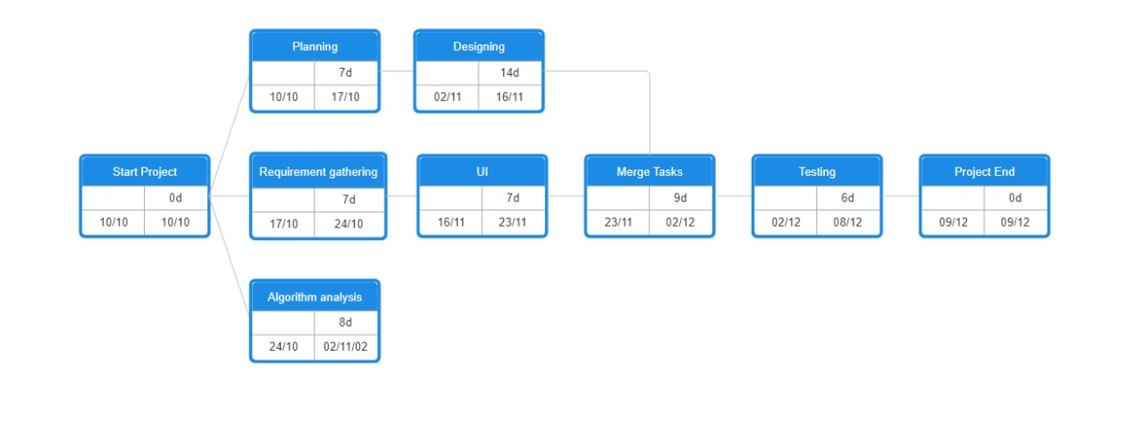
Methodology
The Scrum methodology for Quick Logs involves three key roles: the Product Owner, who defines the vision and manages the backlog; the Scrum Master, who facilitates the process and resolves roadblocks; and the Development Team, which builds and tests features. The project is divided into sprints, typically lasting two weeks, with each sprint delivering incremental features like log ingestion, filtering, and dashboards. Daily standups ensure progress tracking and blocker resolution, while sprint reviews and retrospectives focus on feedback and improvement. The product backlog prioritizes tasks such as log parsing, error filtering, and visualization tools. Tools like Jira for management, Git for version control, and automated testing ensure efficient and collaborative development.
Pert Chart:

Slide 11
Algorithms
Data Parsing:
• LogEntry Struct: Represents structured data for a log entry.
• parseLogLine Function: Uses std::istringstream to split a log line into components: timestamp, fileType, origin, and message.
• parseTimestamp Function: Converts a timestamp string to a struct tm object using std::get_time with the format %Y-%m-%d,%H:%M:%S.
2) Log Analysis:
• Regular Expressions (std::regex): Used for matching and extracting patterns (timestamp, log level, thread, and message).
• Keyword Counting: Checks messages for specific keywords to count occurrences.
• Log Level Counting: Counts occurrences of each log level (e.g., INFO, ERROR) using a std::map.
• Hourly Count: Aggregates logs by the hour for temporal analysis.
• Thread Count: Counts occurrences of log messages by thread.
• Keyword Count: Counts specific keywords in log messages to identify common themes.

Slide 12
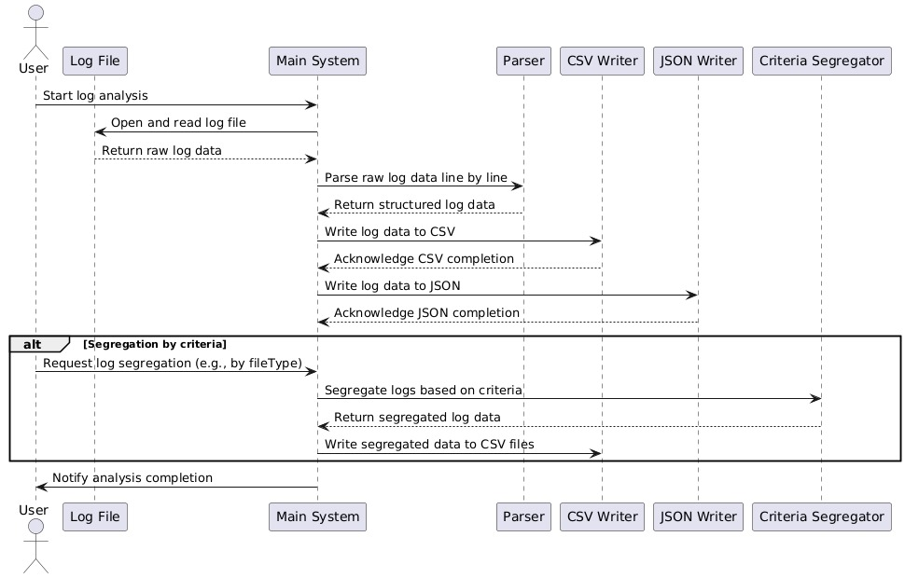
Implementation
Sequence diagram

Slide 13
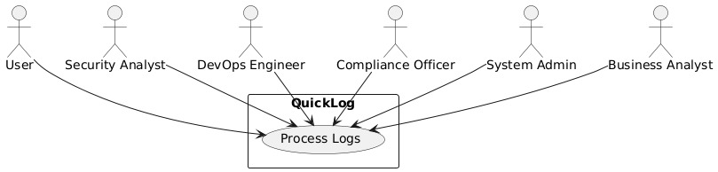
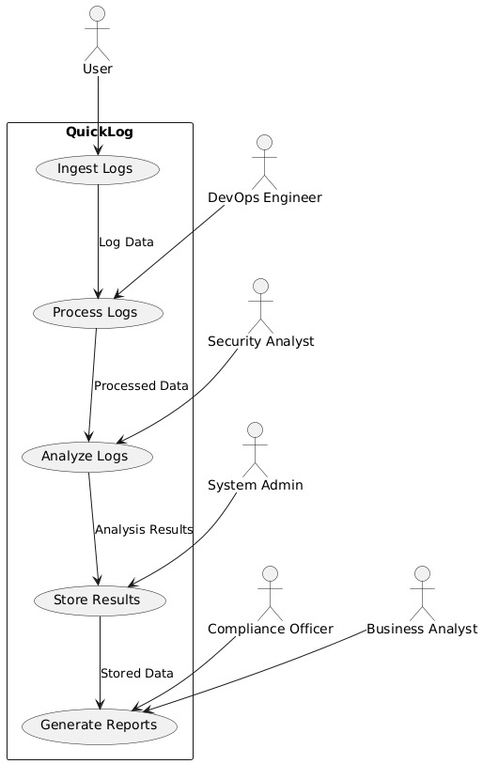
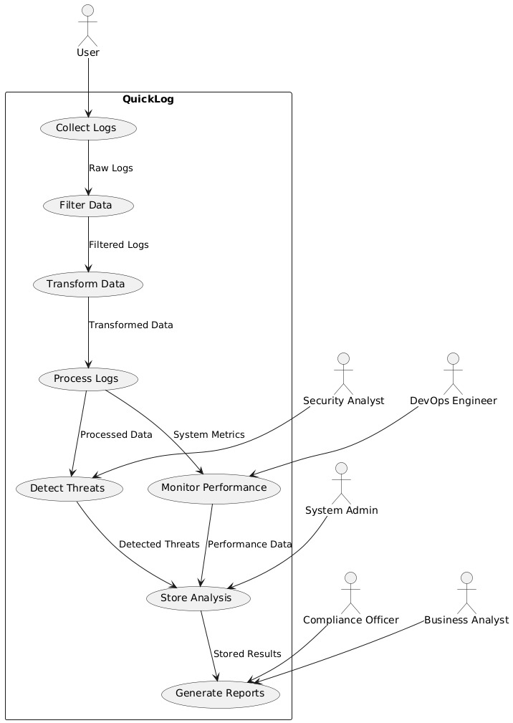
Implementation
DFD’s
DFD Level 0
DFD Level 1
DFD Level 2

Slide 14
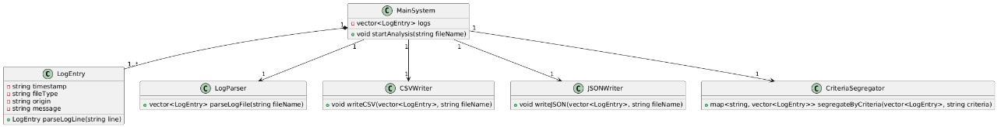
Implementation
Class diagram

Slide 15
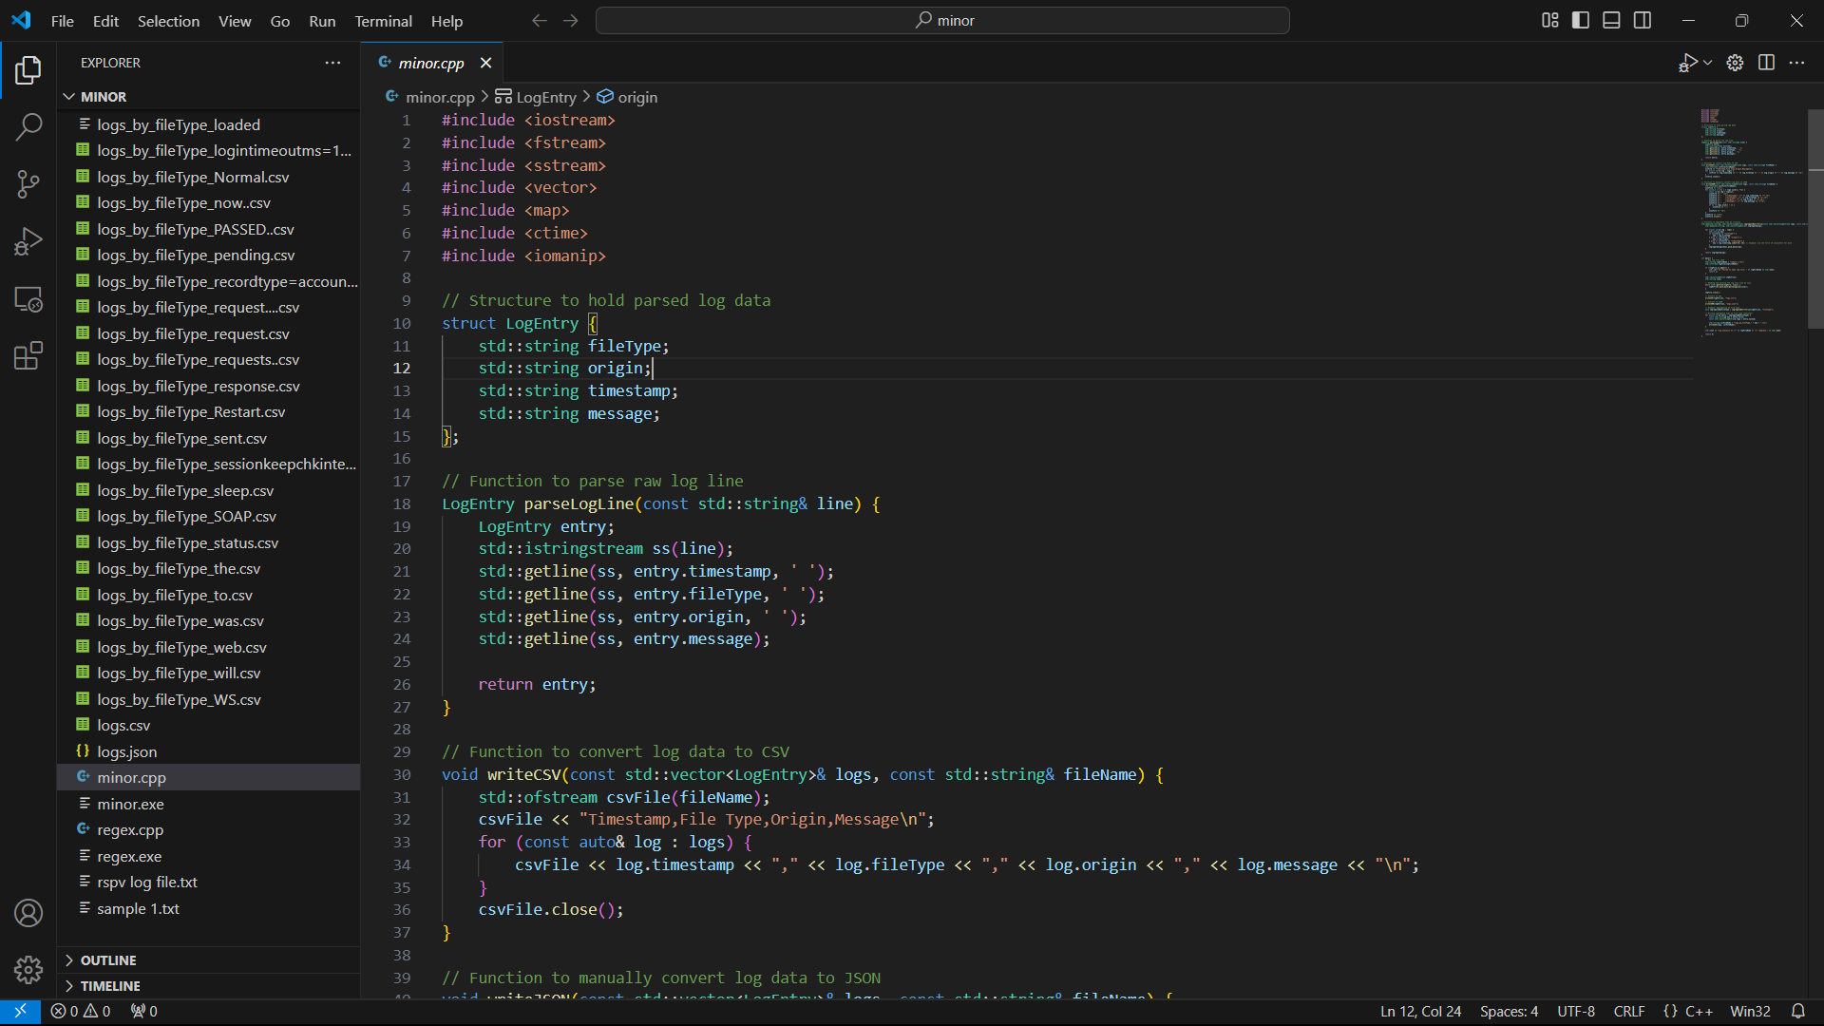
Implementation
Code

Slide 16
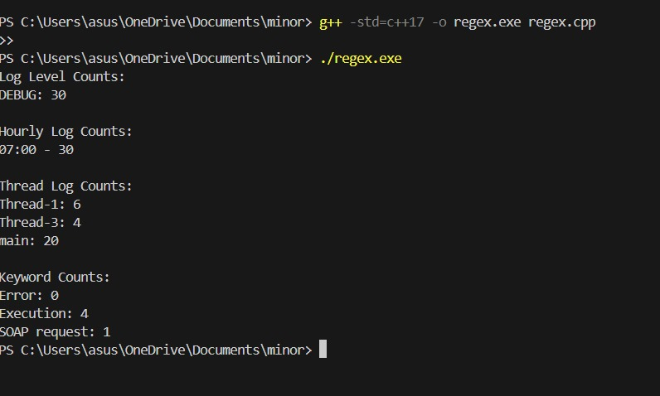
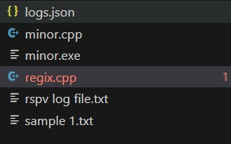
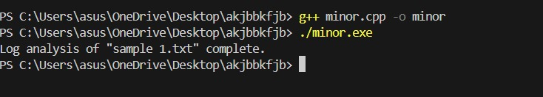
Implementation
Output

Slide 17
Reference
Xu et al. (2009). Detecting large-scale system problems by mining console logs. Proceedings of the ACM SIGOPS 22nd Symposium on Operating Systems Principles (SOSP '09). ~1300 citations. [PDF link]
Fu et al. (2009). Execution anomaly detection in distributed systems through unstructured log analysis. IEEE 2009 International Conference on Data Engineering (ICDE). ~800 citations. [IEEE Xplore]
Oliner, Ganapathi, & Xu (2012). Advances and challenges in log analysis. Communications of the ACM, 55(2), 55–61. ~400 citations. [ACM Digital Library]
Yuan et al. (2014). Simple testing can prevent most critical failures: An analysis of production failures in distributed data-intensive systems. Proceedings of the 11th USENIX Conference on Networked Systems Design and Implementation (NSDI '14). ~500 citations. [USENIX link]
Lou et al. (2010). Mining invariants from console logs for system problem detection. Proceedings of the 2010 USENIX Annual Technical Conference (ATC '10). ~600 citations. [USENIX PDF]
Zhou et al. (2020). Log-based anomaly detection and fault localization in microservice systems. IEEE Transactions on Services Computing. ~150 citations. [IEEE Xplore]
DiMaggio, Carli, & Zhou (2018). A survey of log analysis approaches. International Journal of Computer Applications, 179(4), 1–8. ~90 citations. [ResearchGate link]
Nagappan & Ball (2007). Using software dependencies and churn metrics to predict field failures: An empirical case study. Proceedings of the 1st International Symposium on Empirical Software Engineering and Measurement (ESEM 2007). ~300 citations. [ACM link]

Slide 18
Thank You

